Slide 1
Artificial Intelligence for Customer Data Analytics
Team 05: Muhammad Shawaiz Khan, Ayesha Rashid,
Sameer Kamani, Aamaina Mukarram Tahir Ali, Saif Nazir.
HU Faculty Mentor: Faisal Alvi
Faysal Bank Mentor: M. Ershad Alam

Slide 2



Problem Statement
Faysal Bank seeks a customer data analytics solution that:
predicts customer churn.
utilizes real time data analytics,
visualizes data as user-friendly insights.

Slide 3
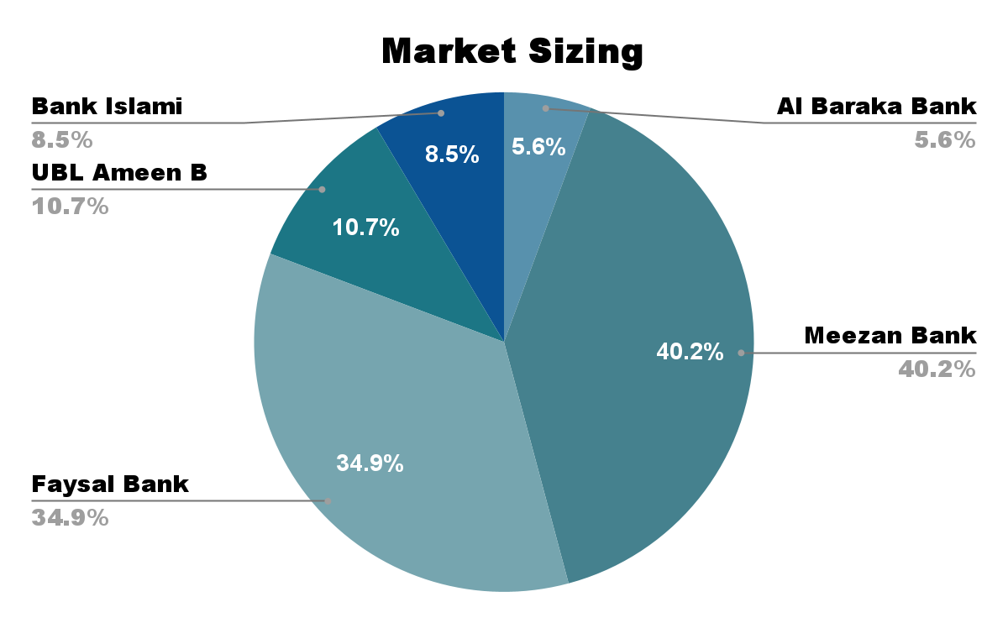
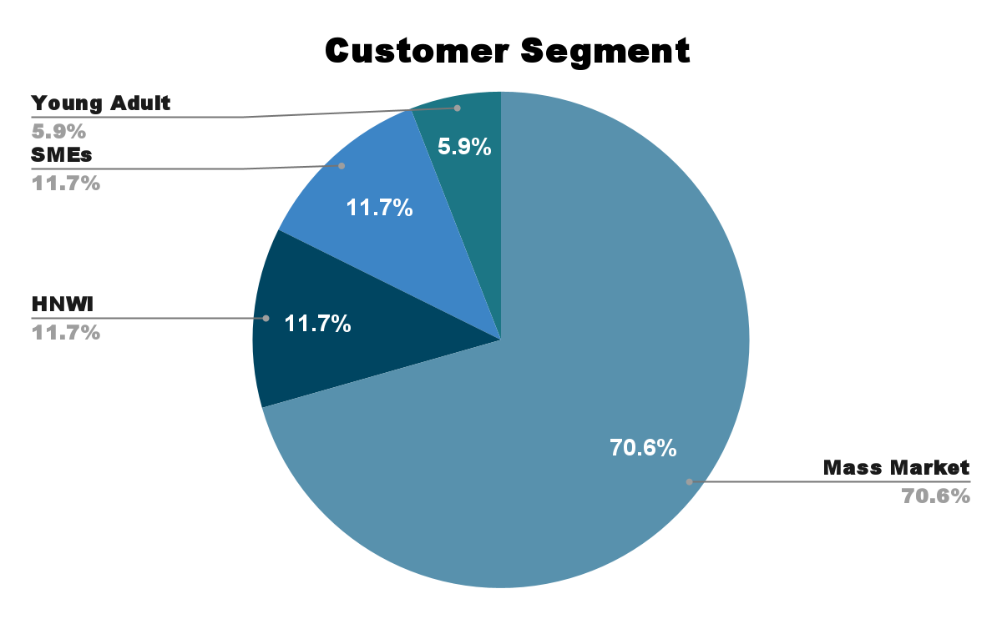
Market Considerations

Slide 4
Our Solution – App Store Analytics Dashboard
We have created an Artificial Intelligence based, multi-tiered solution that provides:
Customer Review Analysis of the Faysal Bank App,
Branch Review Analysis of Faysal Bank’s branches,
Customer Churn Prediction using an AI Model,
Outcome Extraction using a chatbot for bank staff.
Customer Review Analysis
Branch Review Analysis
Customer Churn Prediction
OutcomeExtraction
Chatbot

Slide 5





Customer Review Analysis (App)
Review Count
Others Review Count
Overall
75000 reviews
23,000
2,000
25,000 each
Reviews Analysed:
25,000
Reviews Analysed:
50,000
Faysal Bank App Reviews
Other Banks App Reviews

Slide 6


Customer Review Analysis (App): Filters
Customer reviews on the Faysal Bank App can be filtered by:
VS
Apps
Ratings
Dates
Competitor Analysis

Slide 7
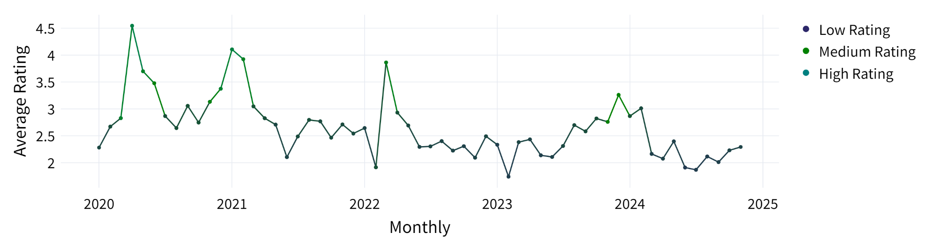
Customer Review Analysis (App): Graphs
Several useful charts can be generated from the analysis dashboard, providing valuable insights.
Here is a graph of average monthly customer comment rating (scale: 1-5).

Slide 8
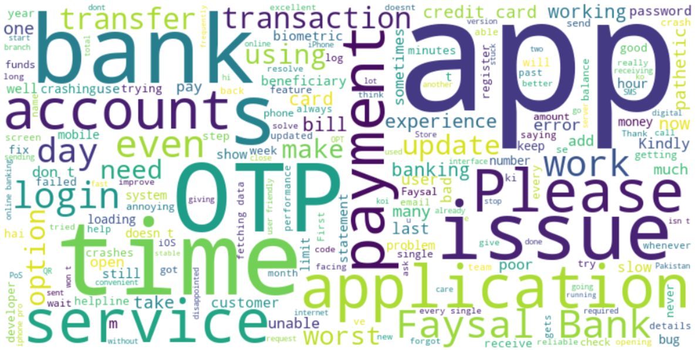
Customer Review Analysis (App): Word Cloud
Word cloud generated corresponding to specific time period.
Helpful in exploring issues of importance to customers (such as OTP, app, service, etc).
Word Cloud generated for the time period 01/01/2022 to 21/11/2024

Slide 9
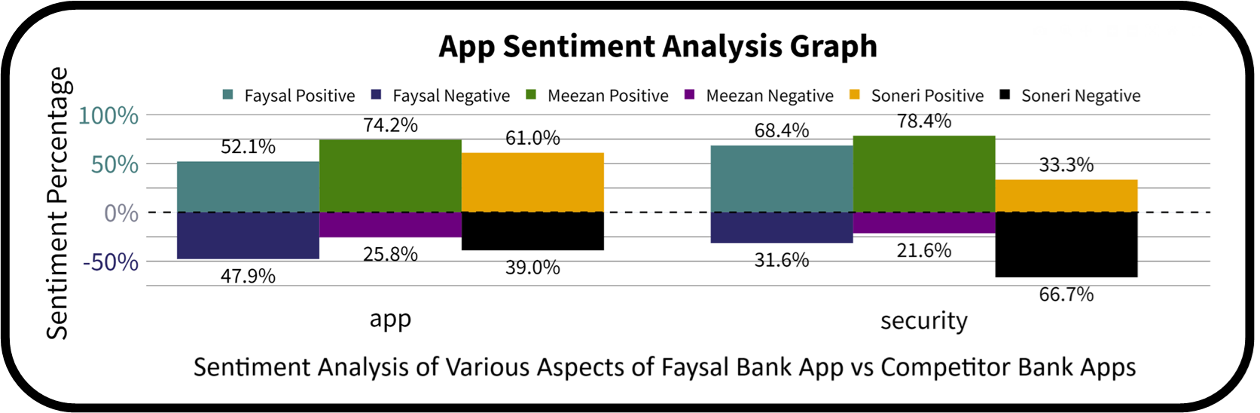
Customer Review Analysis: Sentiment Analysis
Tables and graphs are created from reviews via Sentiment Analysis Tab,
The graph below shows the percentage of reviews that are positive or negative between our chosen banks over various different aspects.

Slide 10
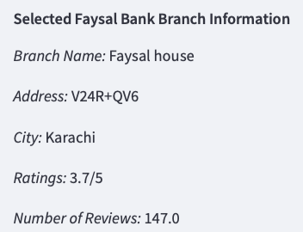


Branch Performance Mapping
Branch performance mapping, provides analysis of branch specific comments.
Comments such as
help identify branch specific issues.
Branch Specific Information by Dashboard

Slide 11
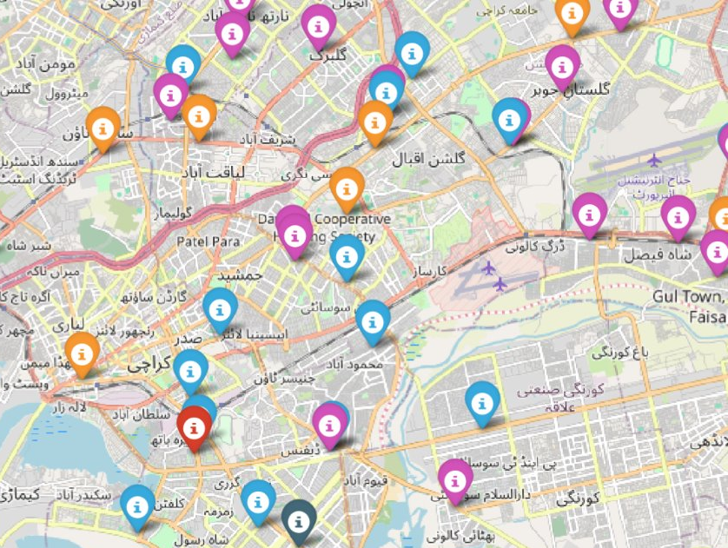



Branch Performance Mapping
Branch Performance Mapping also shows branch density in comparison to competitor banks.
The map on the left shows Faysal Bank branches , vs branches of Meezan Bank and Soneri Bank .
Map of Karachi showing branches of selected banks in comparison with Faysal Bank

Slide 12
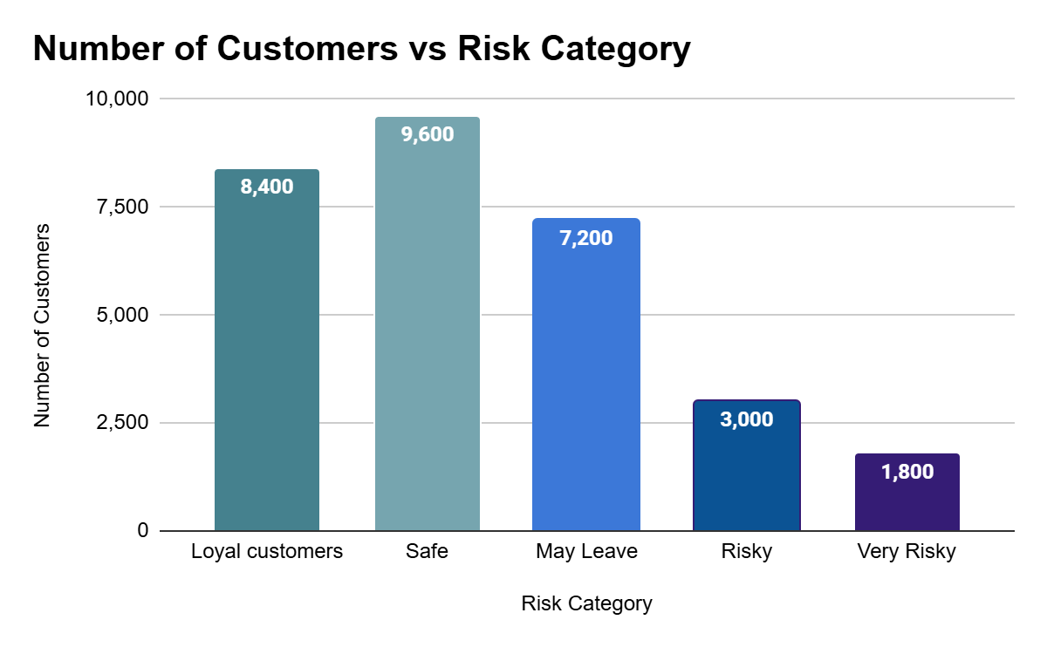
Customer Churn Prediction
Implementation Details:
Trained a predictive Model on 10,000 customers’ data.
Applied the model on 30,000 customers’ data.
Usage:
Model trained with actual data can predict churn and avoid loss of valuable customers.
Customer Churn Prediction on 30,000 customers’ data

Slide 13
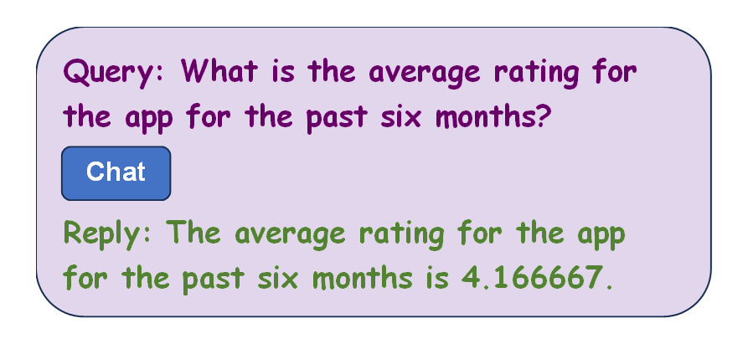
AI Powered Bank Support Chatbot
Primarily intended for staff to generate insights using data.
Automated bank service support, provides accurate, data-based responses.
A sample chat session shown below.

Slide 14
Summary
Our proposed solution using customer data analytics is based on four components.
This will assist the bank in assessing customer sentiment.
Provide valuable data to retain and increase customer base.
Customer Review Analysis
Branch Review Analysis
Customer Churn Prediction
OutcomeExtraction
Chatbot

Slide 15
Thank you
Thank you.

